Slide 1
Lecture 9:
Visualization, Auto-Encoder
Most material from Fei Fei Li’s course at Standford University
Pooya Mohammadi Lecture 9 - 1 Winter-2020

Slide 2
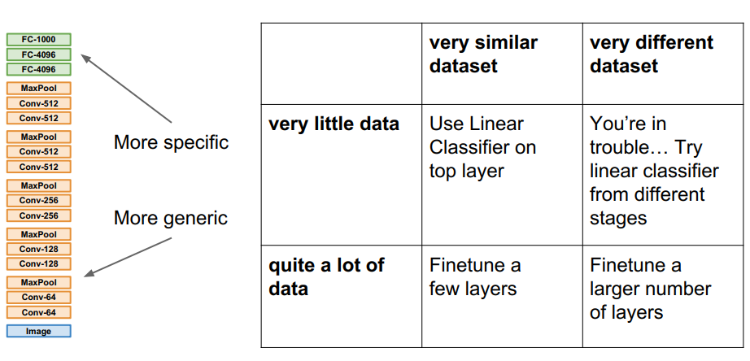
Last time: Transfer Learning
Pooya Mohammadi Lecture 9 - 2 Winter-2020

Slide 3
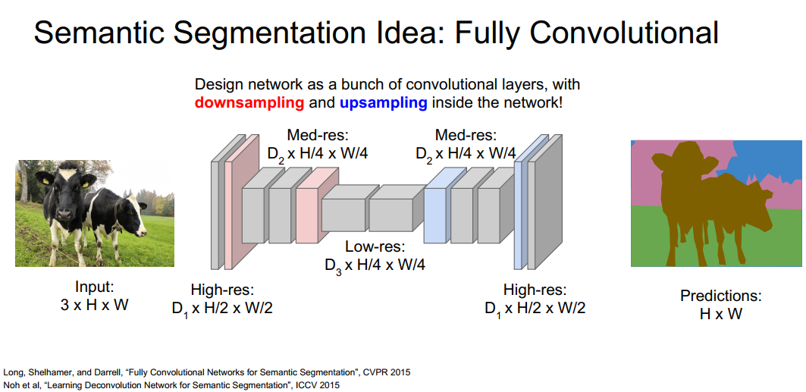
Last time: Semantic Segmentation
Downsampling:
Pooling, Strided Convolution
Design a network as a bunch of convolutional layers, with downsampling and upsampling inside the network!
UpSampling
???
Long, Shelhamer, and Darrell, “Fully Convolutional Networks for Semantic Segmentation”, CVPR 2015 Noh et al, “Learning Deconvolution Network for Semantic Segmentation”, ICCV 2015
Pooya Mohammadi Lecture 9 - 3 Winter-2020

Slide 4
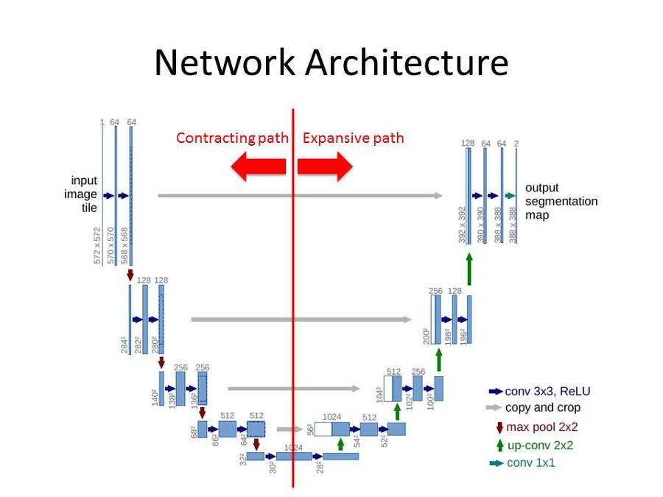
Last time: UNet
Roneberger et al, “U-Net: Convolutional Networks for Biomedical Image Segmentation”, MICCAI 2015
Pooya Mohammadi Lecture 9 - 4 Winter-2020

Slide 5
Today:
Visualization
Auto-Encoders
Upsampling
Pooya Mohammadi Lecture 9 - 5 Winter-2020

Slide 6
Visualization
Pooya Mohammadi Lecture 9 - 6 Winter-2020

Slide 7
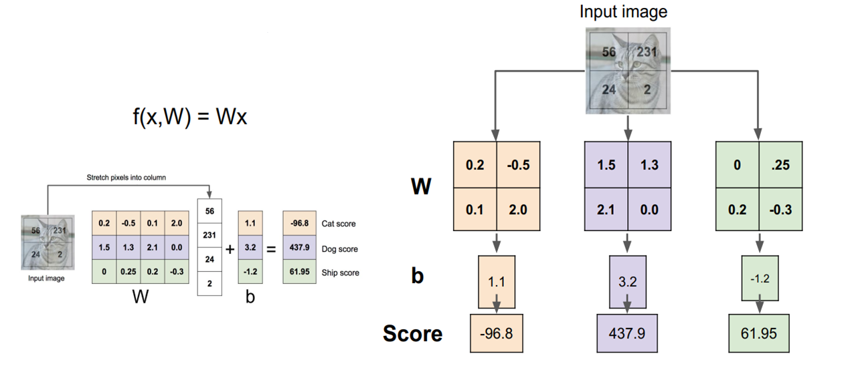
Visualization: Linear Classifier
Example with an image with 4 pixels, and 3 classes (cat/dog/ship)
Pooya Mohammadi Lecture 9 - 7 Winter-2020

Slide 8
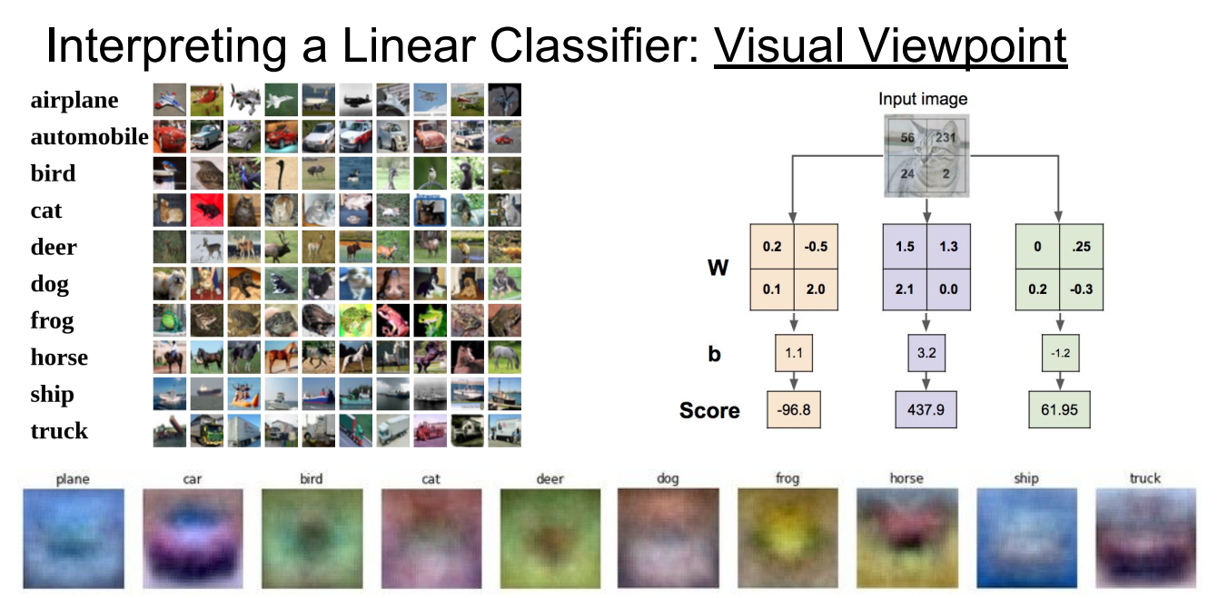
Visualization: Linear Classifier(Visual Viewpoint)
Pooya Mohammadi Lecture 9 - 8 Winter-2020

Slide 9
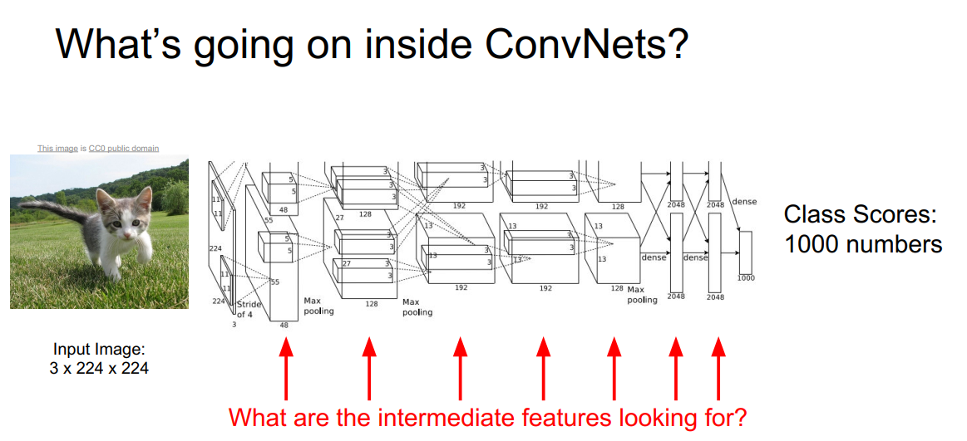
Visualization: Convolutions
What’s going on inside ConvNets?
Pooya Mohammadi Lecture 9 - 9 Winter-2020

Slide 10
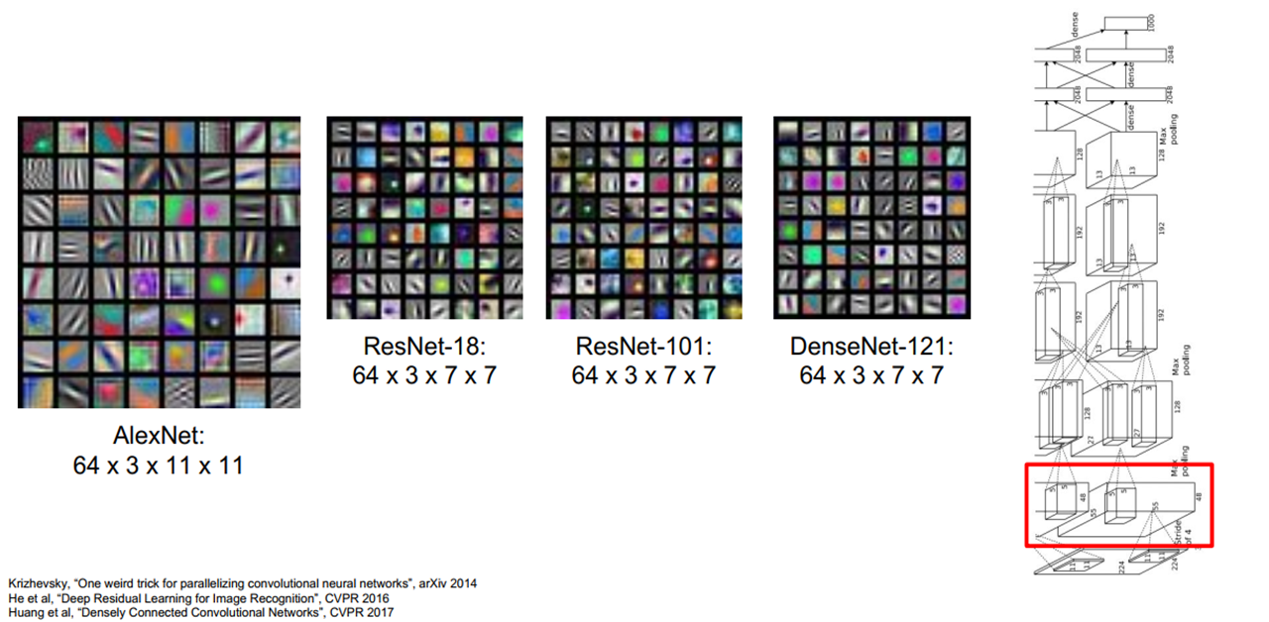
Convolutions: First Layer(Visualize Filters)
Pooya Mohammadi Lecture 9 - 10 Winter-2020

Slide 11
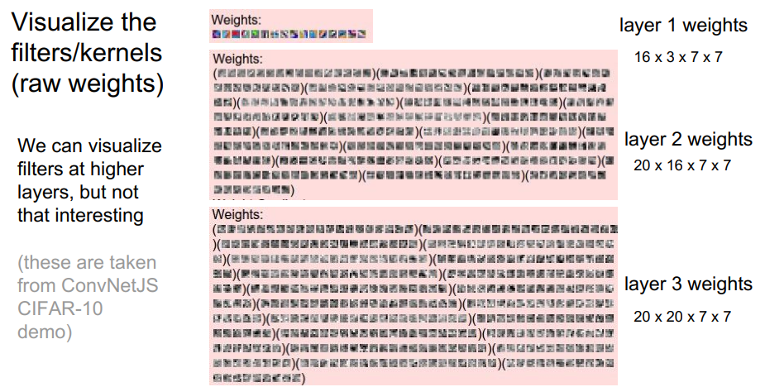
Visualization: Convolutions
Layer 1 weights
16 * 3 * 7 * 7
Visualize the filters/kernels(raw weights)
Layer 2 weights
20 * 16 * 7 * 7
We can visualize filters at higher layers, but not that interesting
Layer 2 weights
20 * 20 * 7 * 7
(these are taken from ConvNetJS CIFAR-10 demo)
Pooya Mohammadi Lecture 9 - 11 Winter-2020

Slide 12
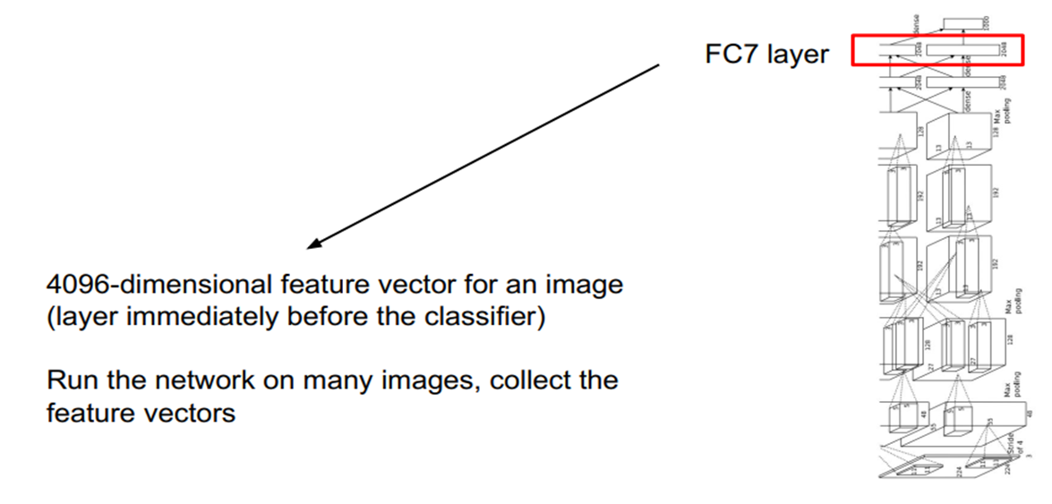
Visualization:
Pooya Mohammadi Lecture 9 - 12 Winter-2020

Slide 13
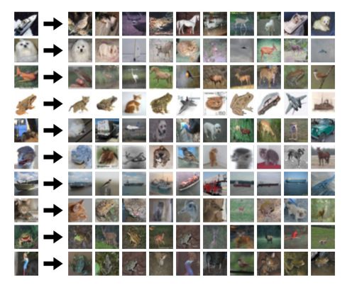
Visualization: K-Nearest Neighbors
Pooya Mohammadi Lecture 9 - 13 Winter-2020

Slide 14
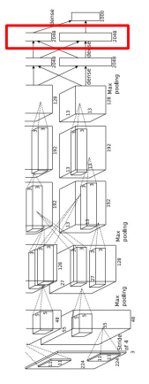
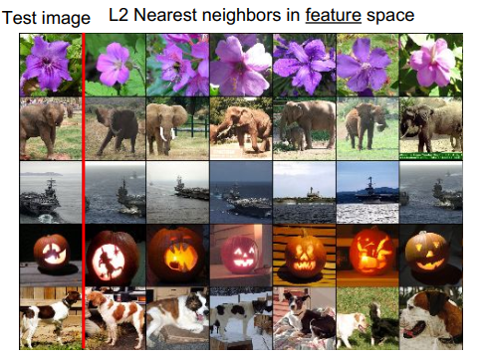
Visualization: Last Layer(NN)
Pooya Mohammadi Lecture 9 - 14 Winter-2020

Slide 15
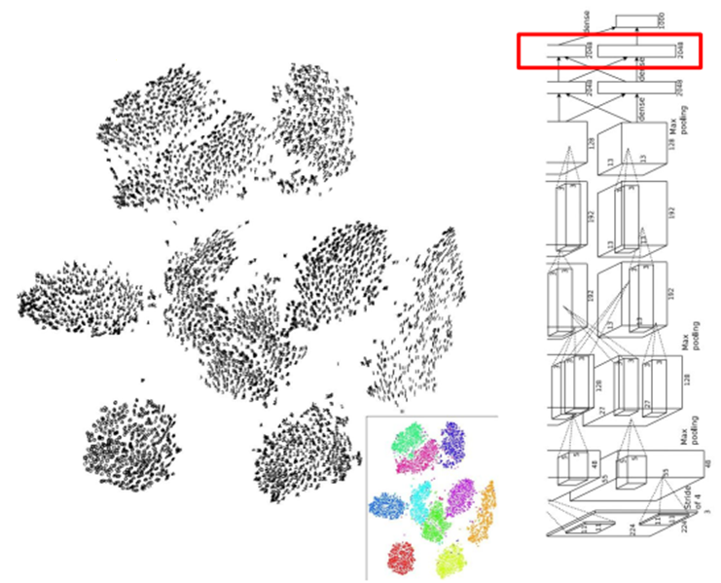
Visualization: Last Layer(Dimension Reduction)
Visualize the “space” of FC7 feature vectors by reducing dimensionality of vectors from 4096 to 2 dimensions
Simple algorithm: Principle Component Analysis (PCA)
More Complex: t-SNE
Van der Maaten and Hinton, “Visualizing Data using t-SNE”, JMLR 2008 Figure copyright Laurens van der Maaten and Geoff Hinton, 2008. Reproduced with permission.
Pooya Mohammadi Lecture 9 - 15 Winter-2020

Slide 16
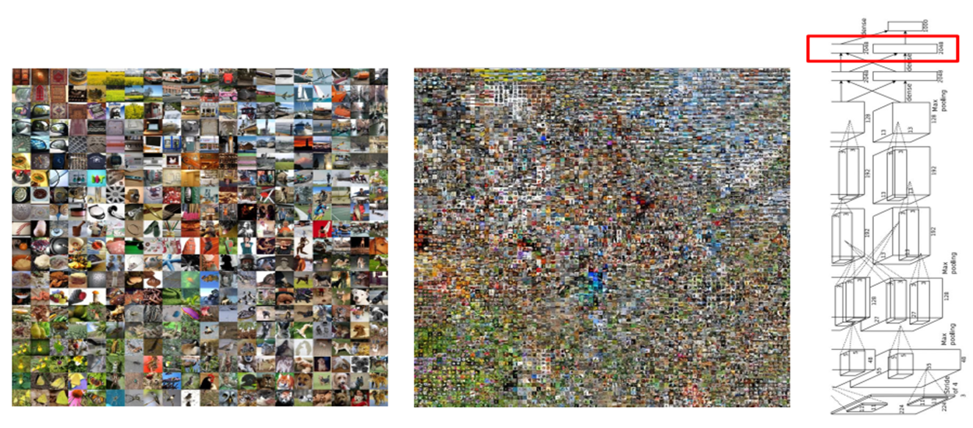
Visualization: Last Layer(Dimension Reduction)
Van der Maaten and Hinton, “Visualizing Data using t-SNE”, JMLR 2008 Krizhevsky et al, “ImageNet Classification with Deep Convolutional Neural Networks”, NIPS 2012. Figure reproduced with permission
See high-resolution versions at:
http://cs.stanford.edu/people/karpathy/cnnembed/
Pooya Mohammadi Lecture 9 - 16 Winter-2020

Slide 17
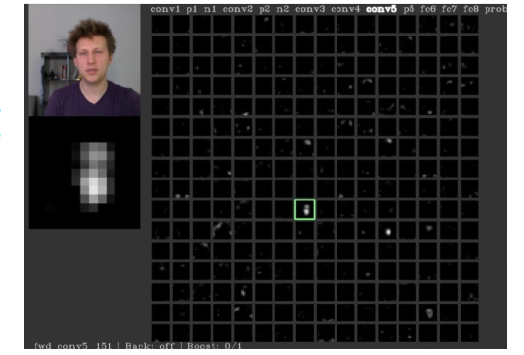
Visualization: Activations
Conv5 feature map is
256*13*13; visualize as 256 13*13 grayscale images
Pooya Mohammadi Lecture 9 - 17 Winter-2020

Slide 18
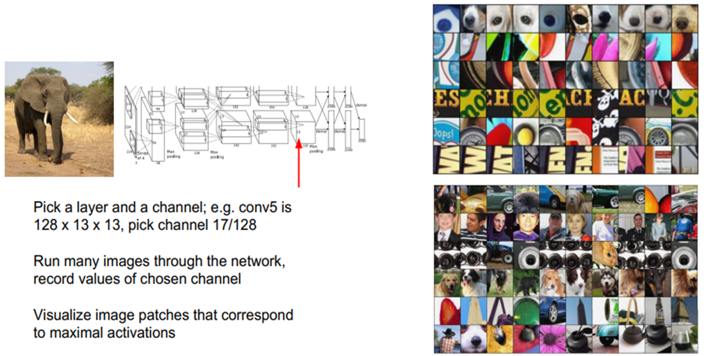
Visualization: Maximally Activating Patches
Springenberg et al, “Striving for Simplicity: The All Convolutional Net”, ICLR Workshop 2015 Figure copyright Jost Tobias Springenberg, Alexey Dosovitskiy, Thomas Brox, Martin Riedmiller, 2015; reproduced with permission.
Pooya Mohammadi Lecture 9 - 18 Winter-2020

Slide 19
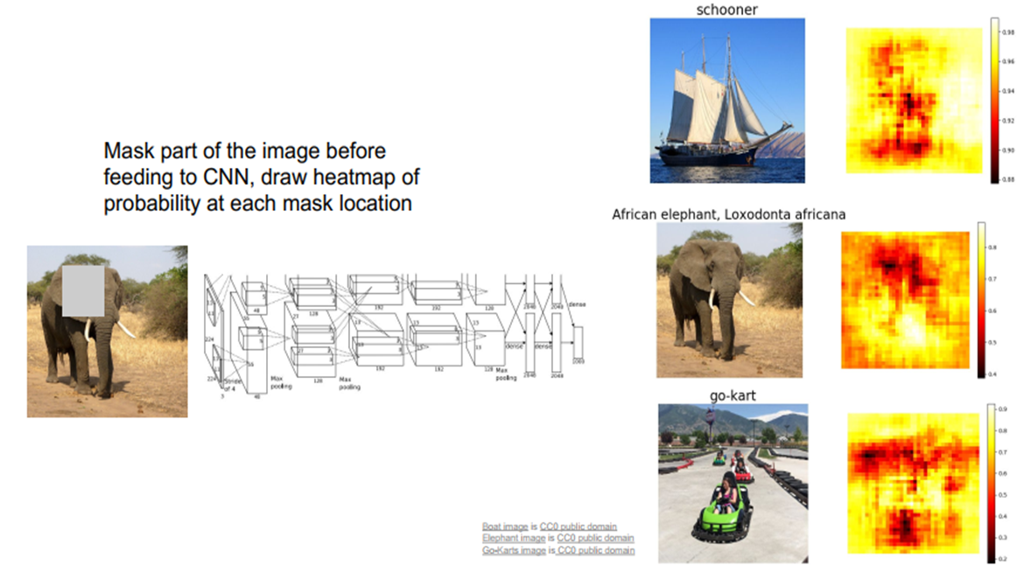
Visualization: Occlusion Experiments
Zeiler and Fergus, “Visualizing and Understanding Convolutional Networks”, ECCV 2014
Pooya Mohammadi Lecture 9 - 19 Winter-2020

Slide 20
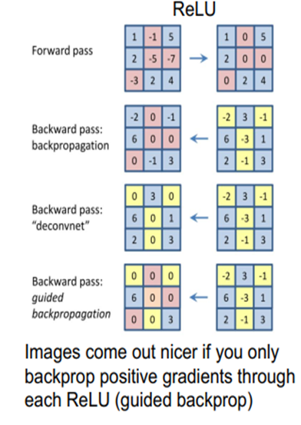
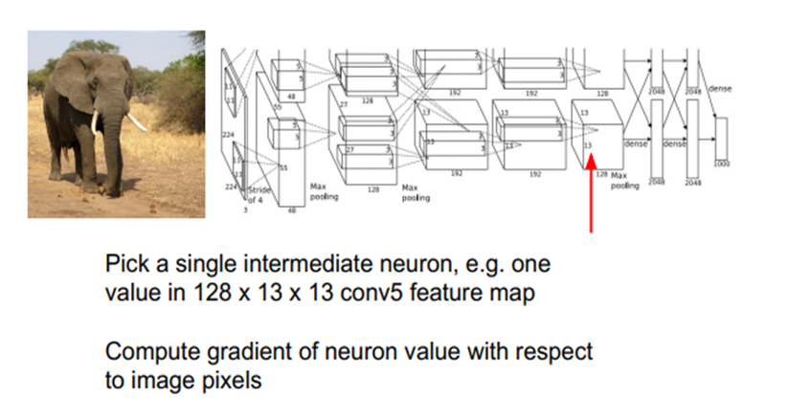
Visualization: Intermediate Features via (guided) backprop
Zeiler and Fergus, “Visualizing and Understanding Convolutional Networks”, ECCV 2014 Springenberg et al, “Striving for Simplicity: The All Convolutional Net”, ICLR Workshop 2015
Figure copyright Jost Tobias Springenberg, Alexey Dosovitskiy, Thomas Brox, Martin Riedmiller, 2015; reproduced with permission.
Pooya Mohammadi Lecture 9 - 20 Winter-2020

Slide 21
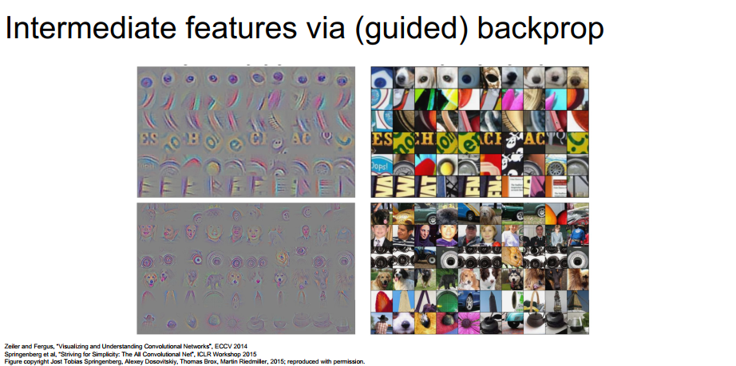
Visualization: Intermediate Features via (guided) backprop
Zeiler and Fergus, “Visualizing and Understanding Convolutional Networks”, ECCV 2014
Springenberg et al, “Striving for Simplicity: The All aConvolutional Net”, ICLR Workshop 2015
Figure copyright Jost Tobias Springenberg, Alexey Dosovitskiy, Thomas Brox, Martin Riedmiller, 2015; reproduced with permission.
Pooya Mohammadi Lecture 9 - 21 Winter-2020

Slide 22
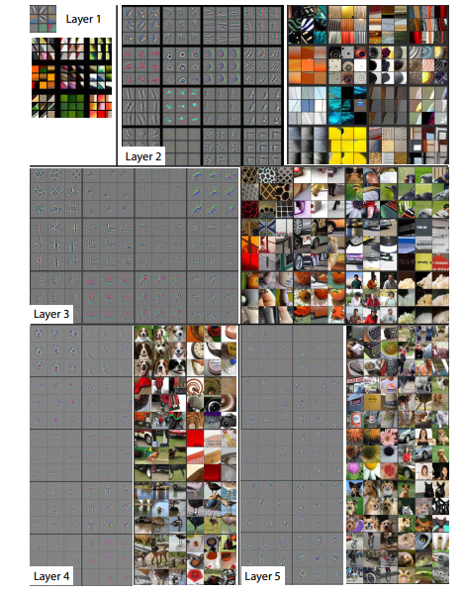
Visualization:
Zeiler and Fergus, “Visualizing and Understanding Convolutional Networks”, ECCV 2014
Pooya Mohammadi Lecture 9 - 22 Winter-2020

Slide 23
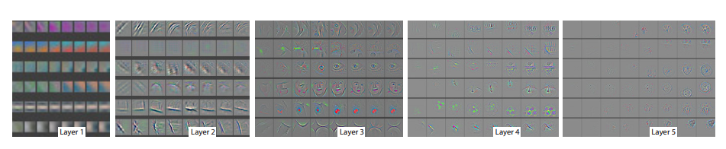
Visualization: Last Layer(NN)
Epochs = [1, 2, 5, 10, 20, 30, 40, 64]
Zeiler and Fergus, “Visualizing and Understanding Convolutional Networks”, ECCV 2014
Pooya Mohammadi Lecture 9 - 23 Winter-2020

Slide 24
Auto-Encoder
Pooya Mohammadi Lecture 9 - 24 Winter-2020

Slide 25
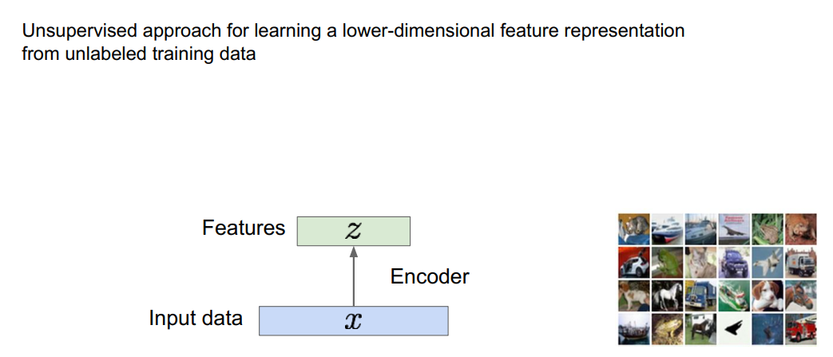
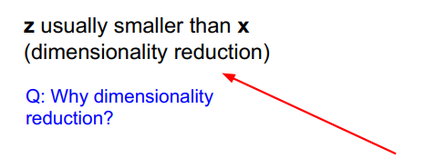
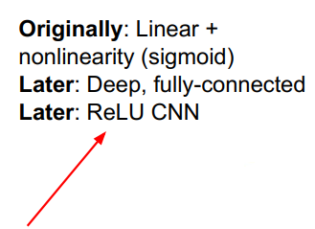
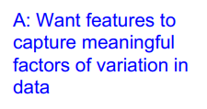
Auto-Encoder:
Pooya Mohammadi Lecture 9 - 25 Winter-2020

Slide 26
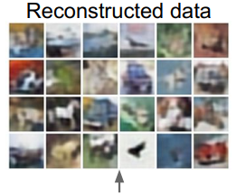
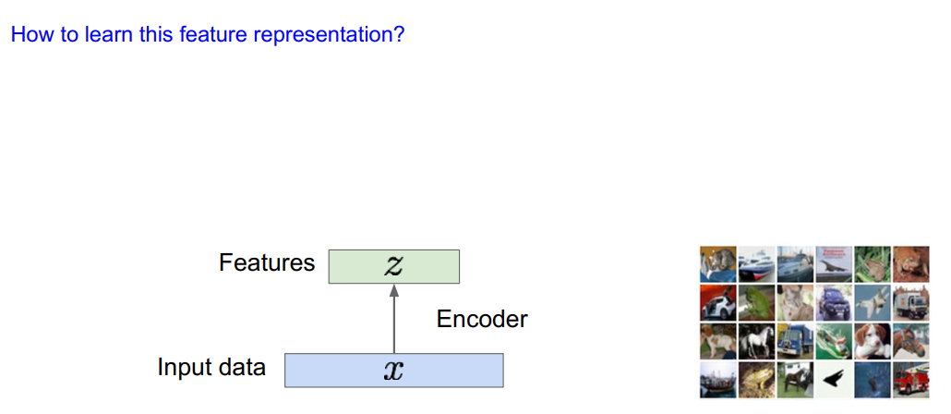
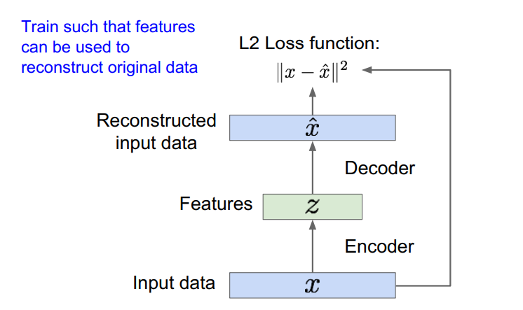

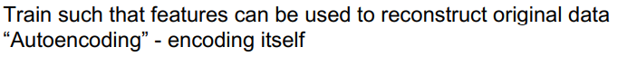
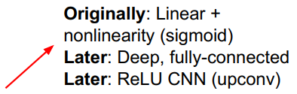
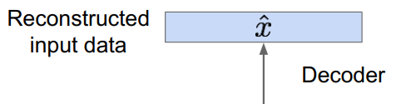
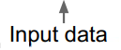
Auto-Encoder:
Pooya Mohammadi Lecture 9 - 26 Winter-2020

Slide 27
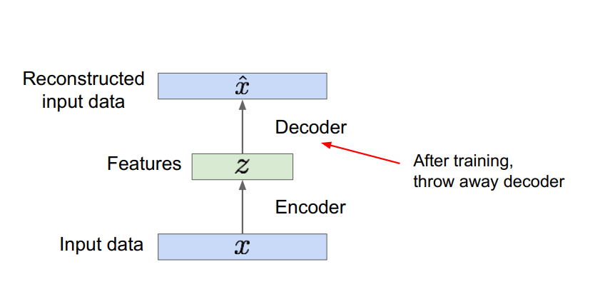
Auto-Encoder:
Pooya Mohammadi Lecture 9 - 27 Winter-2020

Slide 28
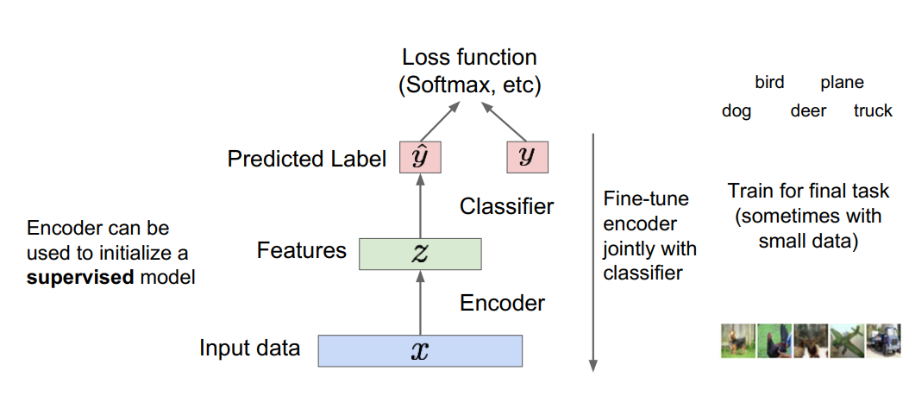
Auto-Encoder:
Pooya Mohammadi Lecture 9 - 28 Winter-2020

Slide 29
Auto-Encoder:
Colorization
Denoising
Pooya Mohammadi Lecture 9 - 29 Winter-2020

Slide 30
UpSampling
Pooya Mohammadi Lecture 9 - 30 Winter-2020

Slide 31
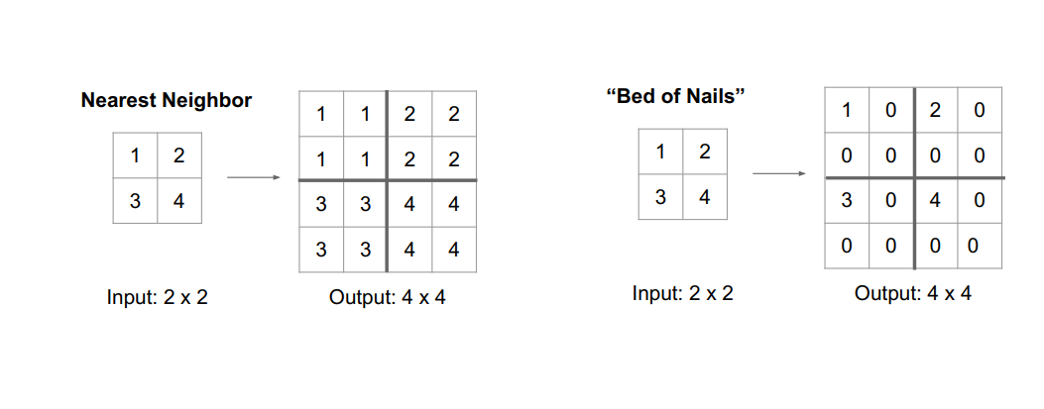
UpSampling: Unpooling
Pooya Mohammadi Lecture 9 - 31 Winter-2020

Slide 32
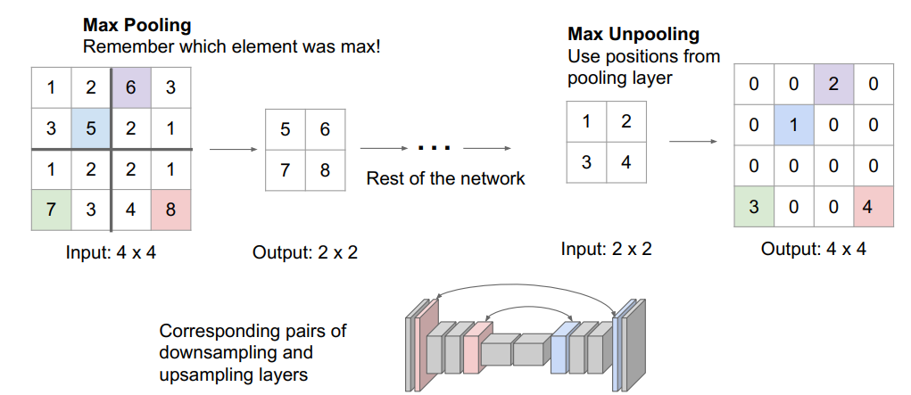
UpSampling:Unpooling
Pooya Mohammadi Lecture 9 - 32 Winter-2020

Slide 33
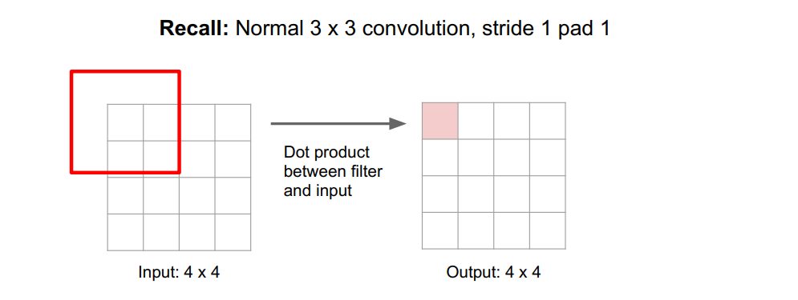
UpSampling: Recall Convolutions
Pooya Mohammadi Lecture 9 - 33 Winter-2020

Slide 34
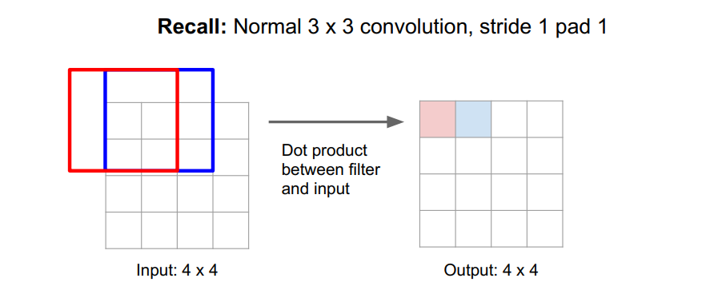
UpSampling: Recall Convolutions
Pooya Mohammadi Lecture 9 - 34 Winter-2020

Slide 35
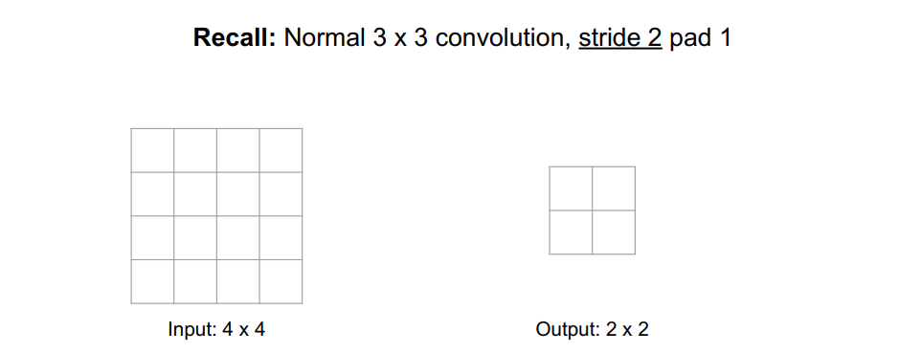
UpSampling:
Pooya Mohammadi Lecture 9 - 35 Winter-2020

Slide 36
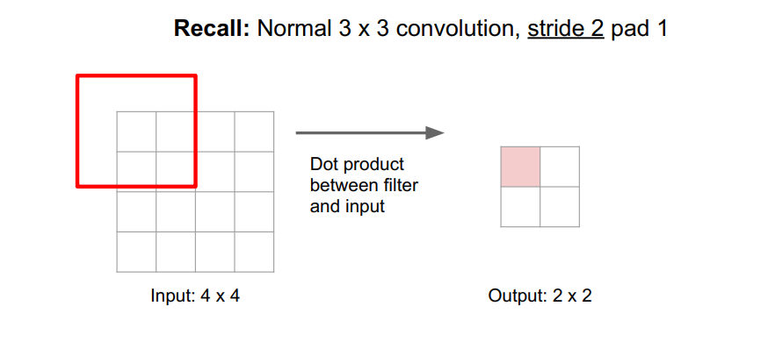
UpSampling:
Pooya Mohammadi Lecture 9 - 36 Winter-2020

Slide 37
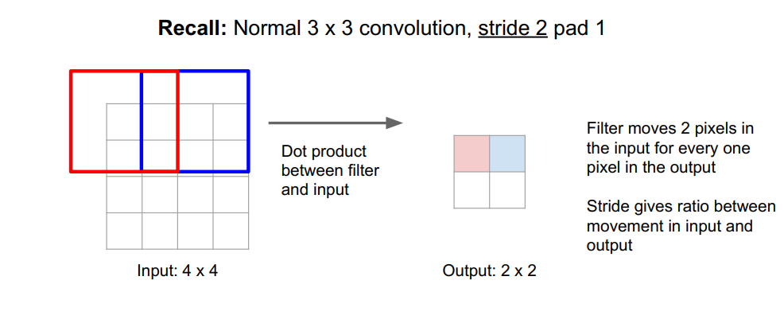
UpSampling:
Pooya Mohammadi Lecture 9 - 37 Winter-2020

Slide 38
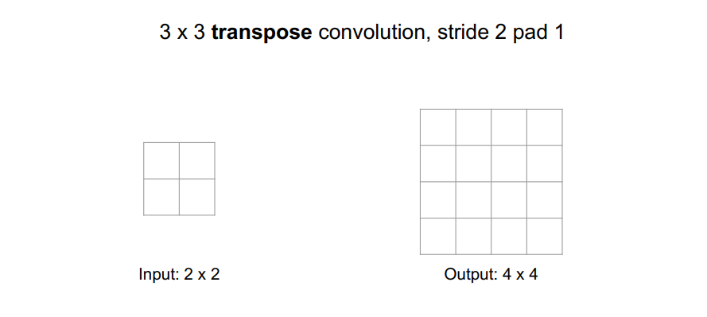
UpSampling:
Pooya Mohammadi Lecture 9 - 38 Winter-2020

Slide 39
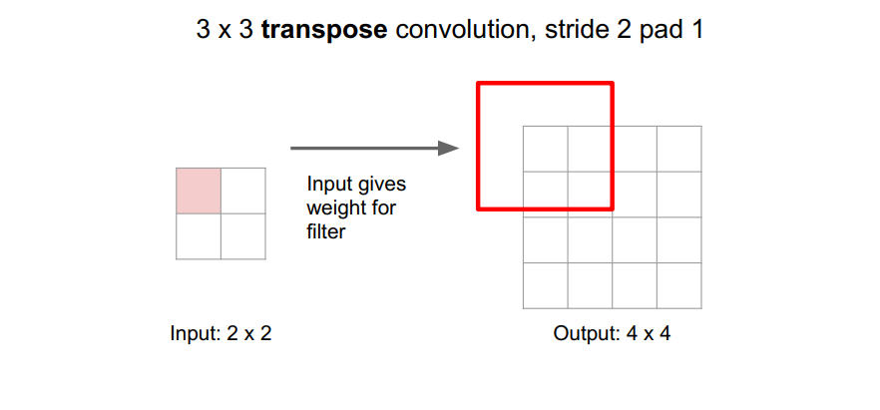
UpSampling: Transpose convolution
Pooya Mohammadi Lecture 9 - 39 Winter-2020

Slide 40
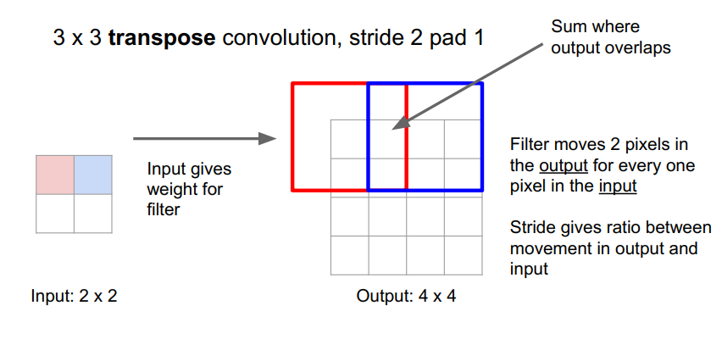
UpSampling: Transpose convolution
Pooya Mohammadi Lecture 9 - 40 Winter-2020

Slide 41
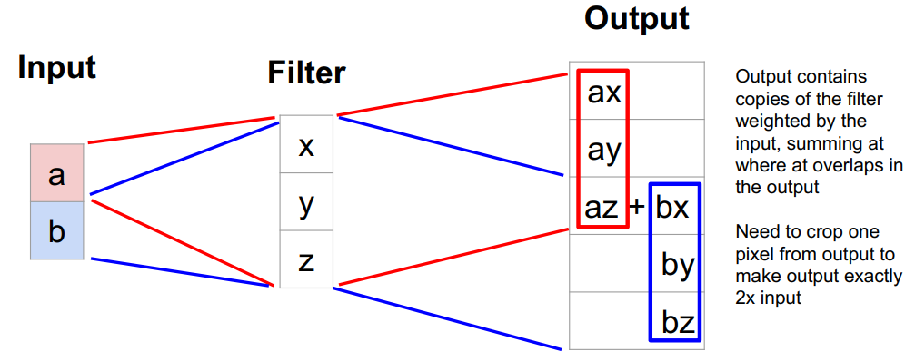
UpSampling: Transpose convolution( 1D Example )
Pooya Mohammadi Lecture 9 - 41 Winter-2020

Slide 42
Question??
Pooya Mohammadi Lecture 9 - 42 Winter-2020

